Slide 1
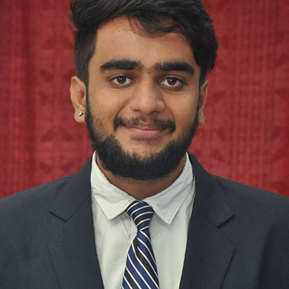

Dhaval Patel
Analyst/Software Engineer
Bachelor of Technlogy, Electronics and Instrumentation : 2016 - 2020
Skills
Java 8 /J2EE | Java Basics, OOPS, Generics, Collections, Arrays, Loops, Lambda Exp, Stream API Junit, Mockito, Servlets
Spring core | IOC & Dependency Injection, Autowire
Spring REST | REST controllers, Implementation of GET, POST, PUT & DELETE, Bean Validation & Exception Handling, Testing Services, Controller & Repository layer
Spring Data JPA | Implement DAO layer using spring Data repositories
Spring Boot Microservices | Spring Boot Starters, annotations, Messaging Service, , Swagger API documents
Spring Cloud | Eureka, Netflix Ribbon, Netflix Hystrix, Netflix Zuul & Config Server
Angular | Components, Services, Modules, Routing, Forms & Validation, Testing using Jasmine & Karma
Database | MongoDB No Sql Basics
UI Tech | HTML 5 & CSS 3,JavaScript, ES6 & TypeScript Optimized UI Designed
Tools | Git, Postman, Maven, IDE
Add On skills | Peer learning
Mumbai
dhaval-ramesh.patel@capgemini.com
+91 8898590896
A4
Full Stack Developer
Hands on experience in creating microservices with Spring boot framework , Spring Security, Spring Cloud API Gateway.
Full Stack developer with Angular
Proficient in creating Single page Web Application in Angular with Authentication with routing.
Hands on experience in developing web pages using HTML5, CSS3, Object Oriented Java script, TypeScript, ES6, JSON, XML. Good understanding of Document Object Model (DOM) and DOM Functions.
Experience in creating documentation with Java docs and swagger and unit testing using JUnit and Mockito.
Knowledge of Spring Cloud Function using Serverless AWS Lambda.
Online Flight Booking System
Case study of Online Shopping Application along with API Gateway, responsive UI with HTML5, CSS, Bootstrap and Angular used as User Interface.

